Slide 1
TQS Continuous Testing Initiative
Current Status as of 4/30/2018

Slide 2
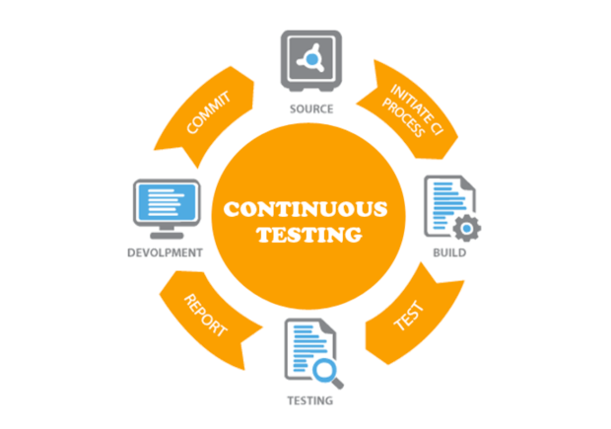
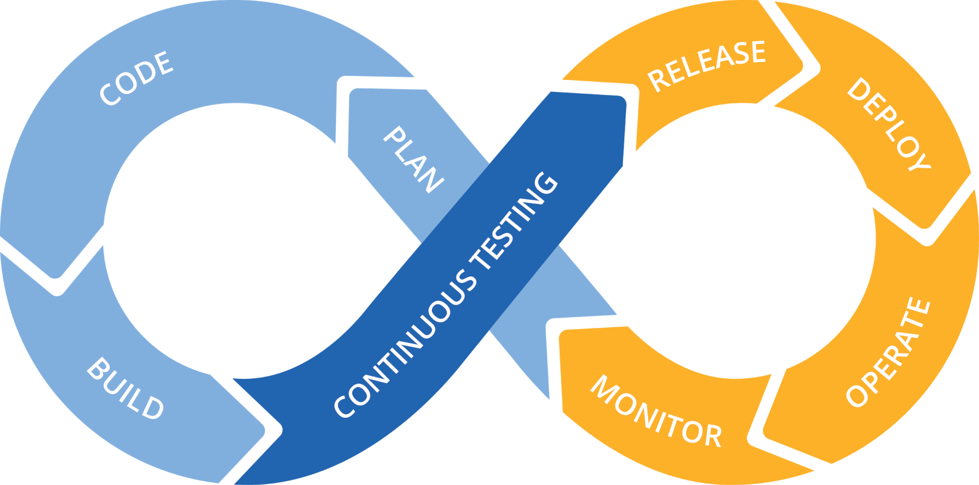
Overview of Continuous testing
Continuous Testing is the process of executing automated tests as part of the software delivery pipeline in order to obtain feedback on the business risks associated with a software release candidate as rapidly as possible.
Continuous Testing Continuous Integration

Slide 3
Software Architecture

Slide 4
Proposed software for CT
Continuous Testing ToolSet
S.No. | Name of Tool | Tool Type | Comments
1 | Jira Software | Plan | Work tracking tool
2 | Bitbucket | Distributed Version Control System | TQS wants to go with BitBuket for centralized TestScripts Repo, lining up with TSYS enterprise.
3 | Git | Version Control | GitBash needs to be installed in windows to push code to BitBucket
4 | Docker | Containerization | Few Containers with Docker and Windows and others with Docker and RHEL
5 | Maven | Build | TSYS wants to go with Gradle when we develop new code.
6 | Gradle | Build | TSYS wants to go with Gradle for all new scripts
7 | ANT | Build | ANT scripts were also used in TSYS. For Instance Credit Care scripts
8 | Jenkins(Opensource) | Continuous Integration | TSYS is good with Jenkins Open Source
9 | Selenium | Automation Tool | Jenkins has plugin for Seleinium
10 | UFT | Automation Tool | HPE Application Automation Tools Plugin
11 | Jmeter | Automation Tool | Performance plugin allows to capture outcome of jmeter /junit in various reporting formats. Jmeter is used for api testing in addition to functional, load, and performance testing.
12 | LoadRunner | Automation Tool | HPE Application Automation Tools Plugin SQS does a POC with Loadrunner to integrate with Jenkins
13 | TestNG | Unit test Framework
14 | QC | Test Mgmt. Tool | use either "Quality Centre" plugin or HPE Application Automation Tools to see QC test results in jenkins dashboard https://plugins.jenkins.io/qc
15 | NVDA | ScreenReader | We are going with NVDA - 1/26/2018 It doesn't fit in CI framework. Its manual
16 | WAVE | Accessibility Evelaution Testing Tool | TSYS is good, CreditCare QA automated Accessibility testing with Wave plugin via Selenium scripts. If so, we can display in Jenkins dashboard, if not its manual process and doesn't fit in CI framework.
17 | SonarQube | Static Code Analysis Tool | SonarQube Scanner plugin is available to integrate with Jenkins
19 | BlackDuck | Security Testing Tool | Jenkins Plugin available for BlackDuck

Slide 5
Current software used and why ?
Jira
Work tracking tool, inherited from G5
Docker
Docker is a Open Source Container software. Containers allow dev/Qa to package up and ship Apps with all its dependencies as one package. Container Jenkins is a good example. Docker enables true independence between applications and infrastructure.
DockerSwarm
Dockerswarm is a Open Source clustering and scheduling tool for Docker Containers. With Swarm, IT admins can manage cluster of Docker nodes as single virtual system. Ex: Swarm is managing Jenkins and MySQL Docker nodes. It has easy learning curve over Kubernetes or over other Docker Orchestration software's
Jenkins
Jenkins is an Open Source Continuous Integration software tool, used for testing and reporting real time in an enterprise large code base
Bit Bucket
Distributed Version Control Software to store Testscripts for both distributed and mainframe apps. Inherited from G5
Ant / Maven
Open Source Build packaging tools. G5 is using Gradle for packaging
Nexus repository Manager
Repository storage hub for storing any Docker images, planning to inherit from G5.
MySQL
MySQL is the Open Source RDBMS database, installed as container, currently used by TCS team
MSAccess
RHEL/Windows
UFT/QTP

Slide 6
Current State for Distributed Systems

Slide 7
Future State - Distributed

Slide 8
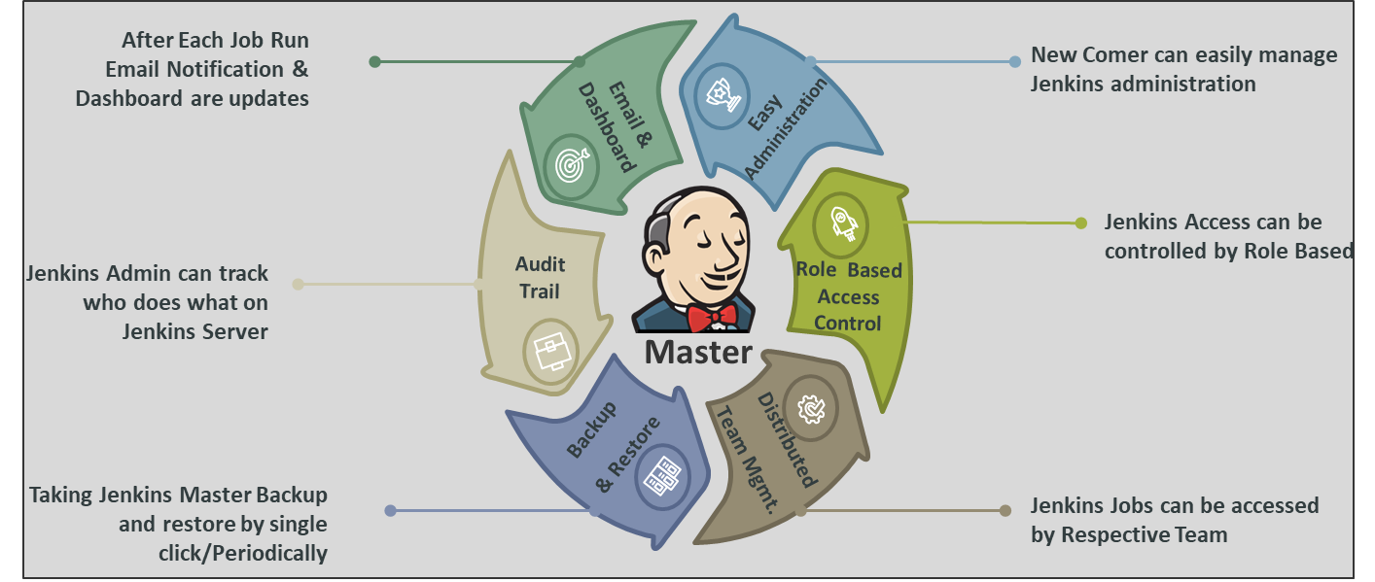
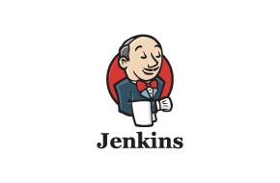




Jenkins maturity
Orchestrated via Jenkins CI/CT Pipeline
1
Slaves
Automation Developers Check-in Code via Bitbucket
Git Check-in Triggers Jenkins Build
Code is Compiled
Selenium/QTP Automation Tests Executed
Publish Test Results in CI/Email Notification
2
3
4
5
6
AUT
Test Results
IDE
Code Repo
Build Agent

Slide 9
Current Status of Distributed Apps
CentreSuite
All scripts are running from centralized CI server for CentreSuite regression.
147 Regression tests are running daily from QA; Around 123 Tests are running daily from development.
Consolidated report emails goes to CenterSuiteAutomationReport@tsys.com
Redo of CentreSuite BAU tests on ARTEMESE framework - WIP
CreditCare
All scripts are running from centralized CI server for CreditCare regression.
34 tests are from CreditCare – TS2Comm and 207 tests are from CreditCare-TS2Con run daily
Consolidated report emails goes to NA_TSYS_Credit_Care_QA@tsys.com
TCS
TCS moved their test scripts partially to centralized CI server
123 tests from TCS-DE-Automation and 39 tests from TCS-WEB-Automation run daily.
Consolidated report emails goes to TCS-Automation-CT@tsys.com
TCS is planning to move rest of their scripts ( daily & weekly)by end of July
QuickRemit
Pushed 50+ tests to BitBucket and working on the job to run from CI server.
QuickRemit planned to push all their Testscripts by end of June 2018.

Slide 10
Current Status on Mainframe App(s)
ACL was opened via Portal ( EDC/NDC) to access BitBucket Server
GitBash software is available for daily check in / check out for all Mainfarme Testers via Portal Group.
Few UFT scripts were checked into BitBucket to do POC
Mainframe automation team leads were trained on BitBucket
Jenkins node Windows 2012 server (DEV-WIN7-33.tsysdev.net ) is available within ISPAN to run UFT scripts
Requested for 2 RHEL boxes to install Jenkins Master and MySQL was past due
Need to move Test Conditioning data from current MS Access to MySQL after setup
One other Windows 2016 server was requested to test concurrent running and scalability of Jenkins nodes to execute UFT test scripts. UFT v12.02 ( current version) and up supports only Windows 2012 R2 servers only. Hence assumption is unlike distributed apps, windows 2016 servers will be out of scope for mainframe apps.

Slide 11
Accomplishments !!!
All of their Selenium automated testscripts are running from centralized location for CentreSuite, and CreditCare, partially for TCI , WIP for QuickRemit and MF
Jenkins back ups are automated once daily via Jenkins console
As part of Jenkins maturity, Audit Trial, role based feature were implemented
Team leads were trained on Jenkins and BitBucket, and docs are in sharepoint.
One consistent HTML report with statistics is set up for each job in Jenkins. Generic Job details are part of email body and custom reports are part of attachment.
We built one centralized DB server using MySQL to consolidate test data
Centralized CI Server ( Jenkins ) and centralized DB server ( MySQL) were containerized via Dockers, few issues still exists.
All these Docker Containers are orchestrated via Docker Swarm
We were able to check in/check out UFT scripts from BitBucket within ISPAN from Mainframe Tester VDI

Slide 12
Pending work
*Mainframe POC of UFT scripts within ISPAN
CreditCare and QuickRemit should be moved from .properties file to MySQL RDBMS database
Storage of Docker images into G5 Nexus Hub
Move entire repo of Testscripts into centralized CI server for distributed apps ; as of now its partial move exception to CentreSuite
Items listed in supporting model and enhancements slide
Any automated Test Scripts from any other distributed apps ? Like TDM, TCI, Health Care, ESB, and Portal etc. ?

Slide 13
Supporting model and Enhancements
Servers Scalability on Jenkins Master and slave nodes
Cost estimation, and approvals from mgmt. team
Training and transition of these new tools and technology to TQS team members
SLA, monitoring, Backups, DRs, performance tracking, HA , GTS support on our Jenkins master, nodes, MySQL, and Docker/swarm .
Providing DNS address for Jenkins Master
Is achieving elasticity on Jenkins nodes important when we know we move to Cloud ?
MySQL database on grants, security, permission, restricted data access pertained to team
Master of Master for Jenkins. One Master for distributed, other Master for MF apps. Architecting for Jenkins scale up for vertical growth
Improve Jenkins security model like Legacy Jenkins may be through Crowd plug in ?
Steps needed to integrate Accessibility testing into Jenkins pipeline
Static Code analysis, and Security Scans of Open Source are going to be manual
Integrate TDM into this Jenkins pipeline via batch process
Need to store TQS Docker images ( Docker and MySQL) into G5 Nexus Repository Manager
List of things/changes to be done to make it cloud ready from architecture perspective
Look at the SQS proposed rest of the tools

Slide 14
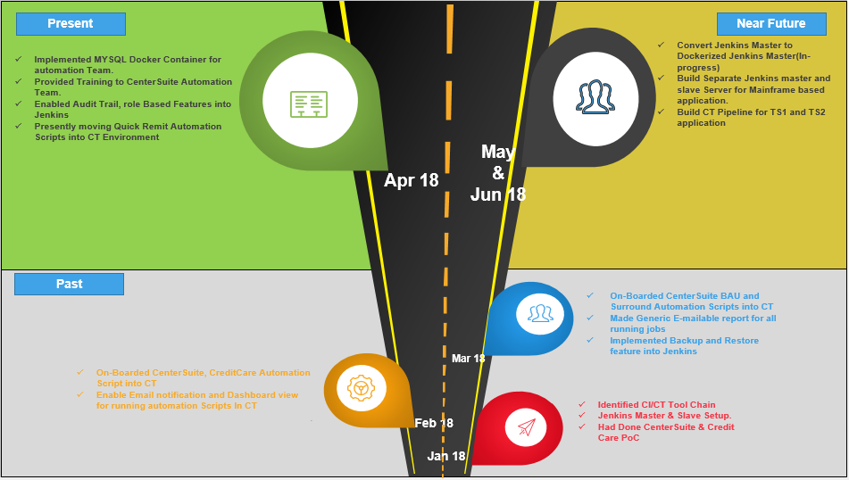
Past, present, and future status

Slide 15
Continuous Testing Ownership
Here are the owners of test Scripts Repo in BitBucket, user access in Jira, and their respective jobs in Jenkins
CentreSuite – Sridevi Jakileti and Joyothi S
TCI – Devesh Gote
QuickRemit – Himanshu Dahiya
CreditCare – Anup Singh
Mainframe Automation Narasimha Suryadevara

Slide 16
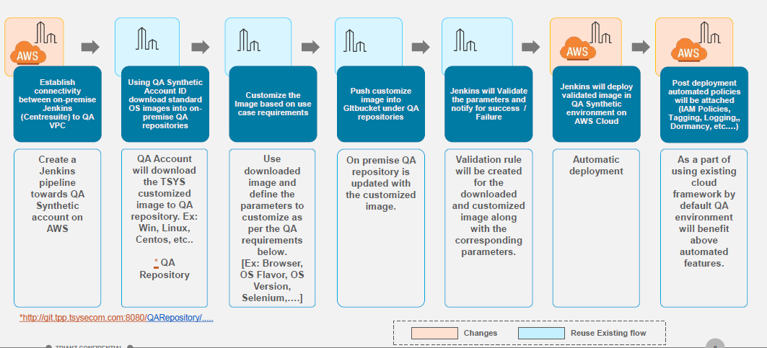
QA deployment in AWS Cloud

Slide 17
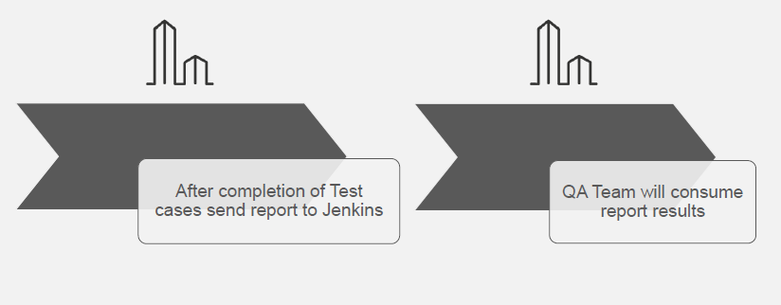
Test Execution Results with Cloud
Test Execution results still remains in Jenkins Master, TSYS on premise, but test execution happens with in AWS cloud. Hence achieving elasticity on test script execution environment on premise will become redundant when we move to Cloud!

Slide 18
Software maintenance
Restore / Back Ups
Disaster Recovery
Maintenance – GTS maintenance
Patches - frequency
Jenkins
Dockers and Swarm
MySQL

Slide 19
Challenges / Lessons learned
We thought one Jenkins will be good enough for both Distributed and Mainframe apps , but to lack of connectivity from TSYSDEV->ISPAN->Mainframe test region, we are going to end up with two different instances of Jenkins 1. within TSYSDEV for distributed apps 2. within ISPAN to execute mainframe apps. Hence one dashboard to see all apps will become challenging
Making sure the current CI set up is cloud ready is challenging because this is first time to TSYS, lack of complete knowledge, and security issues etc.
Setting up the Dockers, Docker Orchestration, Docker Image Storage are challenging due to lack of knowledge in team and vendor
Maturing the Jenkins like implementing the proper Security model, moving stuff from standalone Jenkins to Container Jenkins
Acquiring the hardware and ACLs are challenging, very slow!
Running CentreSuite BAU Test Scripts on ARTEMISE framework, dead slow and vendor scripts are of poor quality !
The Request for Windows servers in DEV can not be processed because they have run out of capacity in the VMWare cluster. So until new hosts are added to the cluster, we won’t be getting new VMs

Slide 20
Training material and URLs
TQS Jenkins
http://10.32.12.95:8282/jenkins/
Jira Planning tool
http://jira.tpp.tsysecom.com:8090/secure/Dashboard.jspa
Bit Bucket Repo for TQS
http://git.tpp.tsysecom.com:8080/projects/TQSCT
Documents on Continuous Testing in Share Point
https://sharepoint.tsys.com/sites/TQS/QD6/Shared%20Documents/TQS%20Automation/
Docker Visualizer for continuous testing
http://10.32.12.97:8080/

Slide 21
Demo
Demo of Jenkins
http://10.32.12.95:8282

Slide 22
Questions ?
Any Questions ?
Thank You!

